Slide 1

MIT COLLEGE OF RAILWAY ENGINEERING & RESEARCH
FINAL YEAR PROJECT PHASE-II FINAL PRESENTATION
AWARENESS, PREDICTION AND DETECTION OF FRAUDS
(CREDIT CARD FRAUD DETECTION)
Under the Guidance of Guide Name
Prof. Srushti Raut
B.Tech In
Department Computer Science and Engineering
MIT COLEGE OF RAILWAY ENGINEERING & RESEARCH,BARSHI
2024-25

Slide 2



- Presented By
SAHIL JAMADAR
RUSHIKESH CHOUDHARI
ROHIT PAWAR
SHIVAM CHINTAMAN
PIYUSH MAHAMUNI

Slide 3
Content
i
1. Introduction
2. Literature Survey of existing system
3. Problem Statement
4.Overview of Proposed System Architecture
5.Implementation Of System
6. Hardware and Software requirement
7.Applications
8.Advantages & Disadvantages
9. Conclusion
10. References for future reading

Slide 4
1.Introduction
Credit Card Fraud Detection using Machine Learning.
Dual Approach: Fraud Awareness & Fraud Detection.
Developing a web-based platform to spread awareness about online frauds.
Implementing ML algorithms (Logistic Regression, Decision Tree, Random Forest, XGBoost) for fraud detection.
Identifying suspicious transactions based on patterns like unusual spending behavior, location changes, and transaction frequency.
User-friendly interface for analyzing fraud trends and retrieving fraudulent data.
Enhancing financial security by minimizing false positives and false negatives in fraud detection.

Slide 5
2.Literature Survey
1)Literature Survey
Traditional fraud detection relies on rule-based methods, which struggle against evolving fraud techniques.
ML algorithms offer better accuracy by analyzing transaction patterns.
2)Existing System
Banks use rule-based fraud detection with historical data analysis.
Lacks real-time detection and adaptability to new fraud trends.
3)Limitations of Previous Systems
High False Positives & Negatives – Misclassifies transactions.
Slow Processing – Inefficient for real-time detection.
Lack of Awareness – Focuses only on fraud detection, not prevention.
Outdated model :
Rule-Based Systems – Uses predefined rules to detect fraud but fails against evolving fraud tactics.
Statistical Methods – Relies on historical transaction data but lacks adaptability to new fraud patterns.
Hidden Markov Model (HMM) – Tracks user behavior but struggles with real-time detection.

Slide 6
3.Problem Statement
PROBLEM STATEMENT :
In today's digital landscape, the convenience of credit card transactions has led to an increase in fraud, costing billions annually and exposing financial institutions and individuals to significant risk. Traditional methods of fraud detection struggle to keep pace with sophisticated scams, and a lack of awareness leaves many vulnerable to cyber threats.
This project aims to address two primary challenges:
Fraud Awareness: Developing an accessible platform that educates users about various types of financial fraud, empowering them with knowledge of risks and preventive practices.
Credit Card Fraud Detection: Utilizing machine learning algorithms to accurately identify fraudulent transactions, reducing false positives and improving detection efficiency. Through this project, we aim to strengthen financial security and promote a safer digital environment by combining fraud detection with user-friendly educational resources.

Slide 7
4. Overview of Proposed system
Data Collection & Preprocessing –
Gathers transaction data, handles missing values, and standardizes features.
2. Feature Selection & Engineering –
Identifies key attributes influencing fraud detection, such as transaction amount
and frequency.
3. Machine Learning Model Training
Uses Logistic Regression, Decision Tree, Random Forest, and XGBoost to
classify transactions.
Fraud Detection & Classification –
Models analyze transaction patterns to label them as fraudulent or legitimate.
Alert & Monitoring System –
Flags suspicious transactions and notifies users for verification.

Slide 8
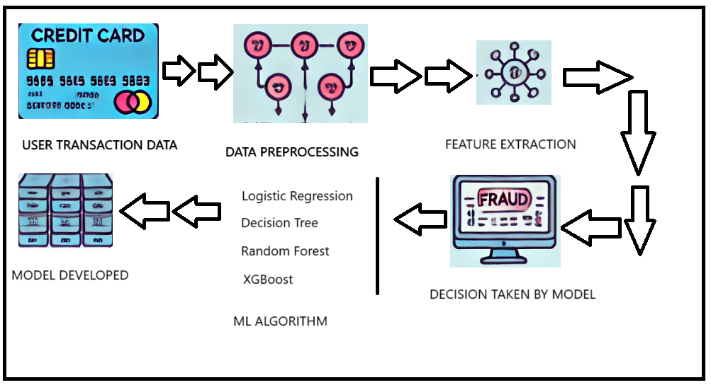
5.Implementation of System

Slide 9
6. Hardware & software Requirement
SOFTWARE REQUIREMENTS:
Programming Language: Python 3.x
Libraries & Frameworks: Pandas, NumPy, Scikit-learn, Seaborn, Matplotlib, XGBoost
Machine Learning Tools: Jupyter Notebook / Google Colab
Database: MySQL / Firebase (if storing transactions)
Operating System: Windows / Linux / macOS
HARDWARE REQUIREMENTS:
Processor: Intel i5/i7 or AMD equivalent (Quad-Core, 2.5 GHz or higher)
RAM: Minimum 8GB (16GB recommended for large datasets)
Storage: Minimum 50GB free space (SSD recommended)
GPU (Optional): NVIDIA GTX 1650 or higher (for faster model training)

Slide 10
7. Applications
Banking & Financial Institutions – Implemented in banks and payment gateways to prevent fraudulent transactions.
E-commerce & Online Transactions – Used by online marketplaces to detect fraudulent purchases and chargebacks.
Insurance Fraud Detection – Helps insurance companies identify false claims and fraudulent activities.
Cryptocurrency Transactions – Applied in crypto exchanges to detect suspicious and unauthorized transactions.
Government & Law Enforcement – Assists in tracking financial crimes and fraudulent activities in public sectors.
Telecom Industry – Used to detect fraudulent SIM card purchases and mobile payment frauds.

Slide 11
8. Advantages & Disadvantages
✅ Advantages:
Dual Functionality: Integrates both fraud detection and awareness—empowering users and securing systems.
High Accuracy: Achieves over 80% accuracy, improving detection effectiveness.
Multiple ML Algorithms: Supports Logistic Regression, Decision Tree, Random Forest, and XGBoost for comparative performance.
Custom Dataset Support: Accepts any well-structured CSV, allowing flexible data input across domains.
User Awareness: Educates users about phishing, scams, and fraud prevention through an easy-to-use website.
⚠ Disadvantages:
Not Real-Time Yet: Current model does not support instant or live transaction monitoring.
Pattern Dependency: Requires CSV files to follow a specific format or schema.
Limited Generalization: May need further training to detect newer fraud patterns or international transaction behaviors.
Resource-Dependent: Handling large datasets may demand higher computing power or cloud support.
Website Not Fully Integrated: Full end-to-end deployment (ML backend + frontend) may still be under development.

Slide 12
9.Conclusion
Our project integrates a credit card fraud detection model with a website for awareness, creating a comprehensive approach to fraud prevention. The machine learning model efficiently identifies fraudulent transactions by analyzing patterns, while the website educates users about fraud risks and prevention strategies. With an accuracy of over 80%, our system enhances security, reduces false positives, and helps financial institutions combat fraud effectively. Future improvements may include real-time detection and deep learning models for even greater accuracy and adaptability.

Slide 13
10.References
[1]. N. Malini, M. Pushpa, ―Analysis on Credit Card Fraud Identification Techniques based on KNN and Outlier Detection,‖ 3rd International Conference on Advances in Electrical, Electronics, Information, Communication and Bio-Informatics (AEEEICB17), Quaid-E Millath Government College for Women, Chennai, India.
[2]. Andrea Dal Pozzolo, Giacomo Boracchi, Olivier Caelen, Cesare Alippi, Gianluca Bontempi, ―Credit Card Fraud Detection: A Realistic Modeling and a Novel Learning Strategy,‖ IEEE Transactions on Neural Networks and Learning Systems, Vol. 29, No. 8, 2018.
[3]. Dr. A. Prakash, ―Analysis of the Modern Techniques and Methods on Credit Card Fraud Detection,‖ PG & Research Department of Computer Science, Hindustan College of Arts & Science, India
[4]. Bhawna Mallick, ―A review of Fraud Detection Techniques: International Journal Credit of Card‖, Computer Applications 975– 8887) Volume 45 No.1, May 2012.
[5]. Peter J. Bentley,Jungwon Kim,Gil-Ho Jung and Jong-Uk Choi, ―Fuzzy Darwinian Detection of Credit Card Fraud‖,2 7.

Slide 14
Thanks !!

